Slide 1
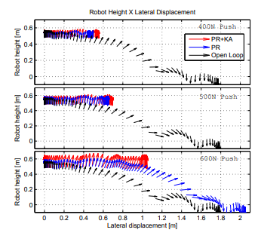
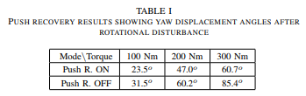
A Reactive Controller Framework for Quadrupedal Locomotion on Challenging Terrain (2013, ICRA)
HyQ
Mass: 70kg
The robot get the disturbance during the ‘trot gait’ and always at the beginning of the swing phase of the same pair of diagonal legs.
Gait features: duty factor: 0.55, step freq.: 1.65Hz, step height: 0.08m
Push recovery results showing yaw displacement angles -> algorithm reduces the yaw displacement up to 29%.
Push recovery(PR) + Kinematics adjustment(KA) can hold 600N during 1 seconds
Pushing the robot laterally

Slide 2
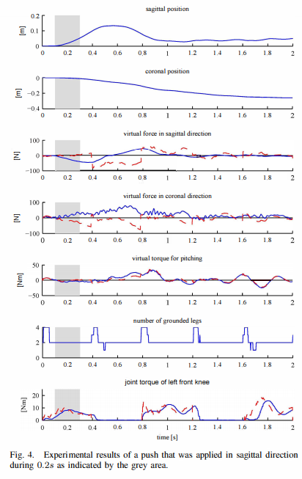
Control of Dynamic Gaits for a Quadrupedal Robot(2013, ICRA)
StarlETH
Mass: 23kg
Leg length: 0.4m
Robustness of the robot was examined by unexpected obstacle while the robot walking on the flat ground.(5cm height obstacle)
External pushes applied in the sagittal direction for a duration of roughly 0.2s.
No gait conditions, maximum forces

Slide 3
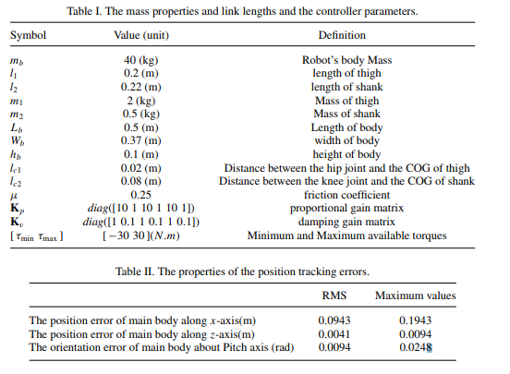
Push recovery of a quadruped robot on challenging terrains(2017, Robotica)
Only simulation
Mass: 40kg
All external forces are applied at sagittal plane.
250N is applied during 0.1s on the robot over an even terrain
200N is applied during 0.1s on the robot over an inclined terrain(10 deg)
200N is applied during 0.1s on the robot over an soft terrain

